Slide 1

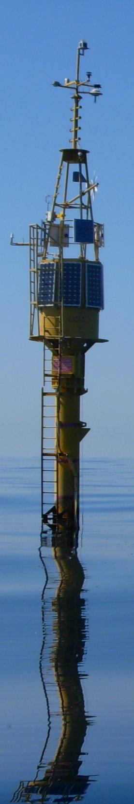

Multidisciplinary Observations at the W1-M3A Observatory in the Ligurian Sea
Roberto Bozzano
Sara Pensieri

Slide 2
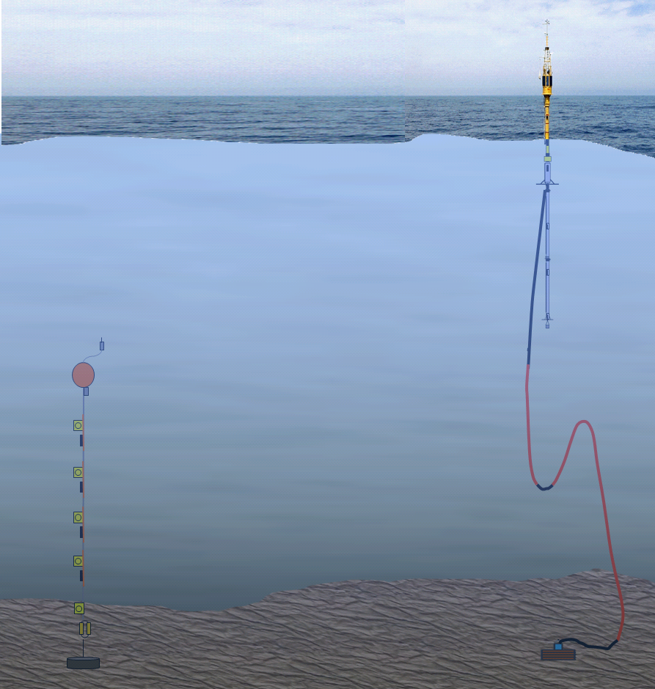
The Observatory
There are two main installations that form part of the W1M3A observatory:
a large spar buoy (known as "ODAS Italia 1", 51 meter long and 12 tons weight) held in place permanently by a long slack mooring and collecting atmospheric and upper ocean measurements (0-40 m);
a sub-surface mooring (100- 1200 m) periodically deployed close-by the main surface buoy and hosting instruments for collecting physical measurements about the ocean.
lower atmosphere processes
+
near surface ocean
physical and biogeochemical properties
+
ocean interior physical properties
1200 m
3000 m

Slide 3
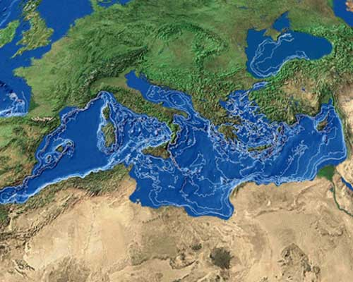
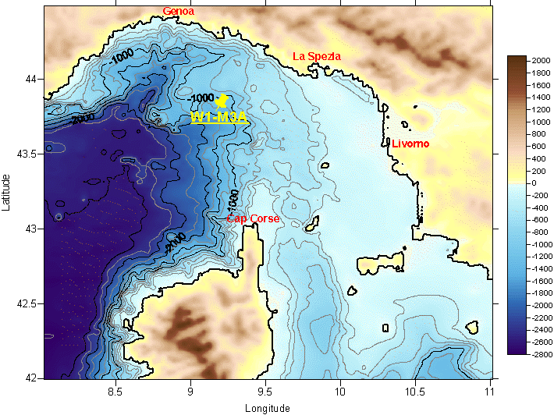
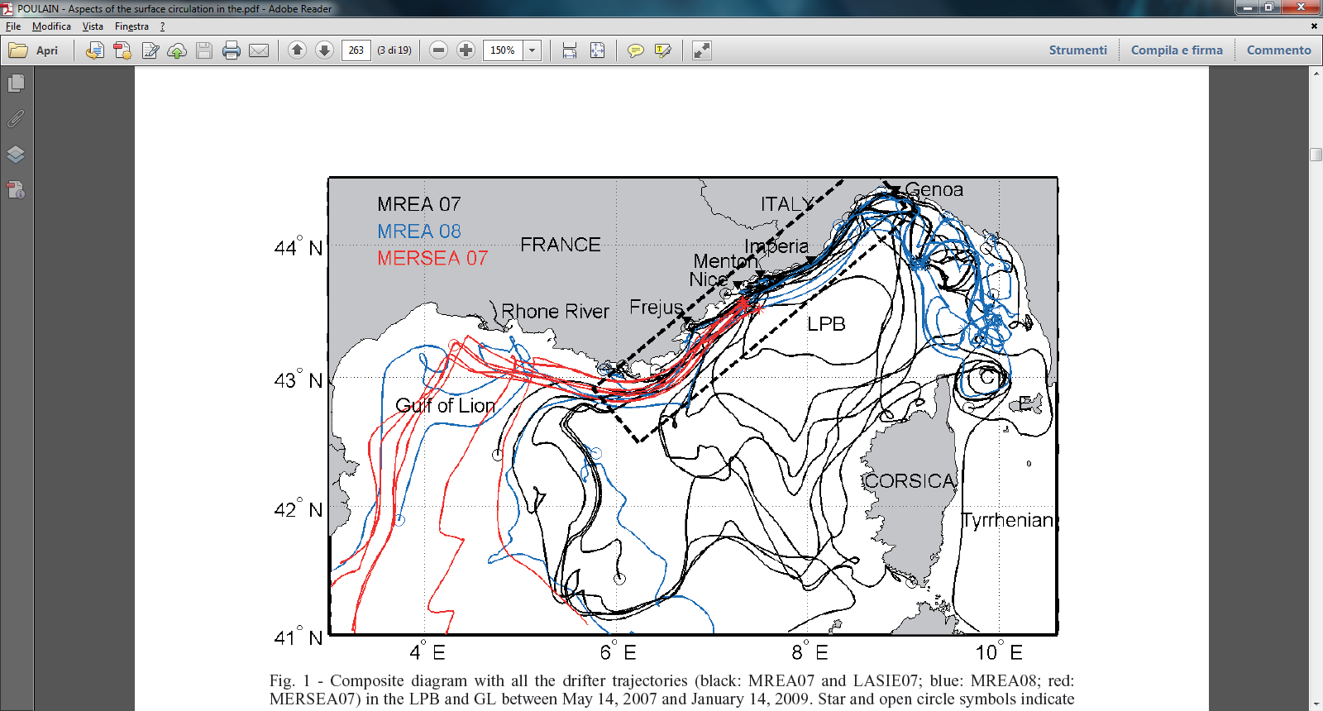
The Local Environment
The Ligurian Sea is a 3000 m-deep basin surrounded in the North by the Apennines and limited by Corsica to the South.
These topographic constraints as well as the thermal contrast between land and sea give rise to specific local effects that influence the general circulation of both atmosphere and ocean, causing strong variability in the upper ocean.
70% of all depressions that form in the Mediterranean appear in the Ligurian Sea.
LPC
ECC
WCC
Notes:
The general circulation of the Ligurian Basin is characterised by a permanent basin-wide cyclonic circulation involving both the surface Modified Atlantic Water (MAW) and the lower Levantine Intermediate Water (LIW). Nonetheless, significant inter-annual variability is observed as well as an intense mesoscale activity with marked seasonal variations.
Due to the interplay of these particular climatic, oceanographic and physiographic factors, the area is highly productive and hosts a rich and complex ecosystem. This is also sustained by vertical mixing and coastal upwelling, generated by the prevailing north westerly wind, which pumps deep nutrients and other organic substances contributed by rivers into the euphotic zone where they fertilize growing phytoplankton populations.
Hence, the area attracts several cetacean species and is part of the "Cetacean Sanctuary" protected area, established to preserve the richness and variety of the ecosystem.

Slide 4
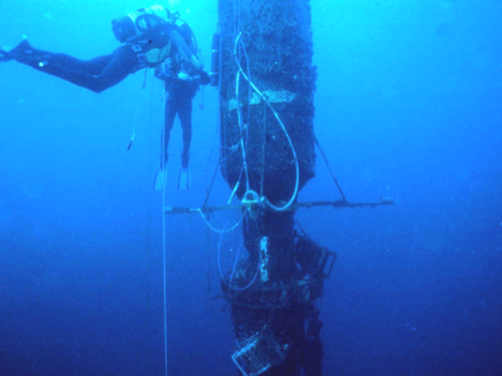
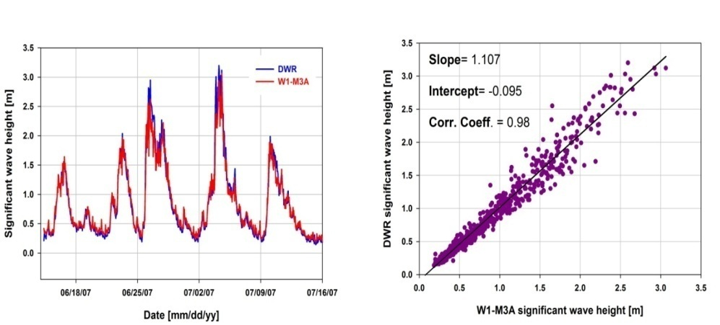
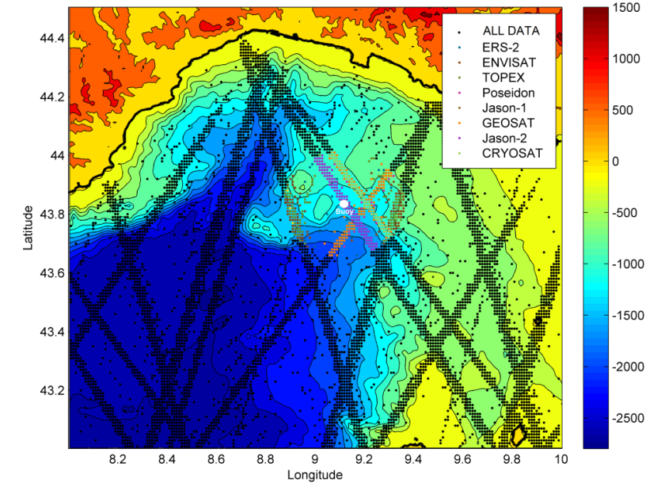
Model vs. Data Comparison for Wave Height
Directional array of three precision acoustic altimeters installed in an upward looking configuration on three equally spaced supports 10 meters depth.
Calibration of the wave meter system using a co-located (4 Km apart) Datawell Waverider.
Objectives of the analysis:
Evaluation of the spatial and the sampling variability inherent in the satellite measurements calibrated using buoy networks (GlobWAVE project by ESA).
Skill of the satellite altimeters to correctly represent the wave climatology of the Ligurian Sea.

Slide 5
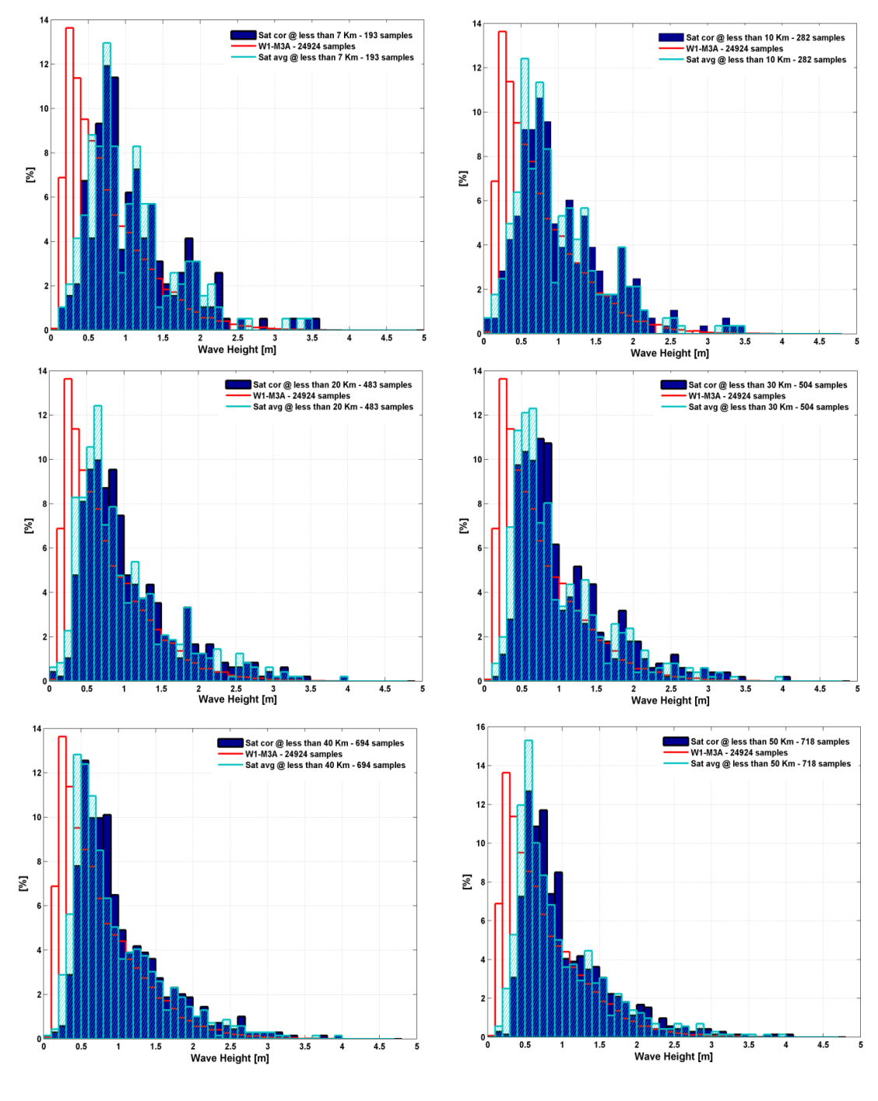
Model vs. Data Comparison for Wave Height
W1M3A data from 2000 up to 2011
Buoy samples: 24924
Satellite samples: 718
The best fit of the two distributions is achieved considering satellites swaths within 40 Km from the buoy.
The satellite SWH distribution shows an elevate percentage of high waves with respect to the measured one and an unusual frequency of rough sea for the basin.
The distribution corresponding to the raw average satellite estimates shows a better agreement with the in-situ observations with respect to the corrected satellite data.

Slide 6
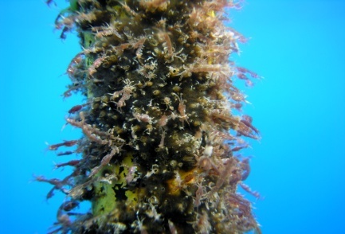
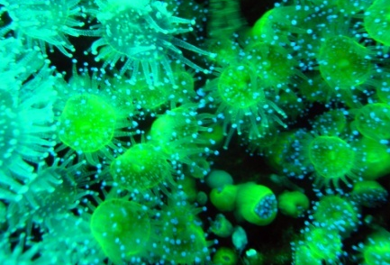
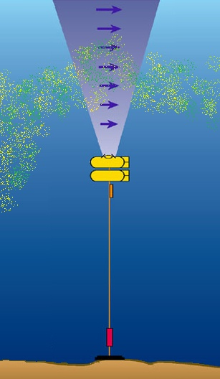
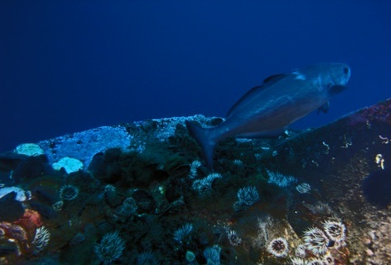
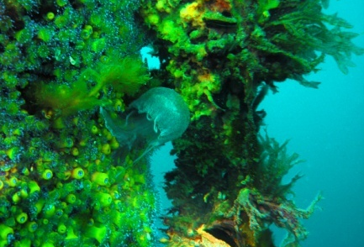
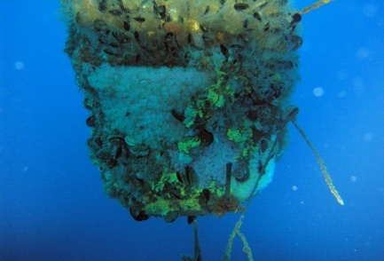
Biological Monitoring - How to Exploit Ancillary ADCP Data
The Ligurian sea hosts the Cetaceans Sanctuary protected area which is characterized by a high productivity and a very complex and rich ecosystem.
Acoustic backscatter profiles offer the opportunity to study the zooplankton distribution and its variability on different temporal and spatial scales.
Three years of observations (09/2003 – 02/2006) of echo intensities and vertical velocities, obtained from an ADCP deployed in the subsurface mooring close to the buoy, were analyzed in terms of variations in the zooplankton distribution.
Notes:
ADCP provides ancillary data, in particular the echo intensity profile that is dependent on the presence of scatterers (e.g., biomass, sediment, bubbles) in the water column.
The analysis of these data has been successfully applied in different scientific investigations, such as the detection of zooplankton migration, suspended sediments, sea surface conditions.
Different configuration set-ups.
All deployment oriented to the investigation of air-sea interactions (i.e., winds & waves by ADCP).

Slide 7
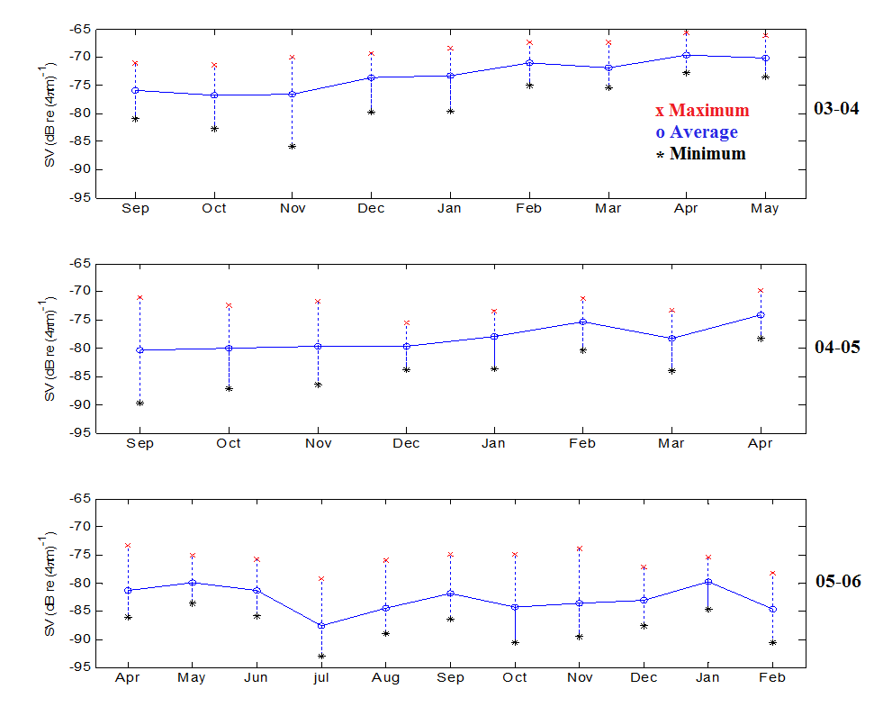
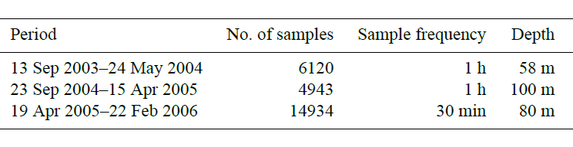
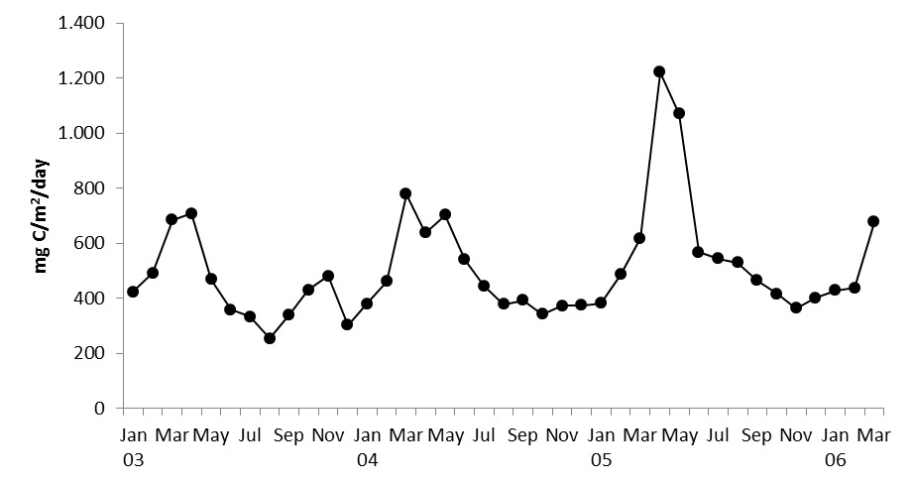
Biological Monitoring
Values of net primary production estimated from the vertically generalized production model based on MODIS and SeaWIFS measurements were used as proxies of surface primary production in the area.
Zooplankton dynamic is characterized by late winter and summer blooms which are preceded by phytoplanktonic blooms related to environmental factors including stratification.
In Northwestern Mediterranean Sea, the late winter bloom is usually delayed to spring.
Notes:
1. http://www.science.oregonstate.edu/ocean.productivity
2. Monthly mean daily cycle of backscatter strength values at different depths.
Considering the normal delay of about 1 month between peaks of surface production and the increase in zooplankton biomass values of NPP may help to interpret the ADCP observed profiles.
The measure of the echo intensity scattered by the ocean is usually given in terms of volume backscattering strength (Sv) in dB re (4 m)−1.
The backscatter strength (Sv) was computed for each beam and then averaged following the expression proposed by Deines (1999) and Gostiaux and Varen Haren (2010).
The used Sv values have been computed using Eq. (5), discarding the bin closest to the transducer, as well as the one closest to the sea surface since it may be strongly affected by the atmosphere.
The pattern of backscattering strength values is consistent with NPP trends with an expected delay of about 1 month between the peak of surface primary production and the response by the zooplankton community. Indeed, the peak of zooplankton biomass is recorded in April–May (Fig. 4) after the peak of NPP in March–April.
Despite the significant inter-annual differences, a fairly constant characteristic in the time series of the monthly mean hourly Sv data is the presence of a marked daily cycle, with
low values during the daylight and high ones in the night. In correspondence with the sudden changes in the Sv signal, negative peaks in the early morning and positive ones in the afternoon are found in the monthly time series of the vertical velocity mean hourly values.
A noteworthy agreement results between the time of sunrise and sunset at the mooring position, and the time at which the lowest and highest daily values of both vertical velocity and Sv hourly changes occur, especially for the third period when the used sampling time is set at 30 min. It should be noted that significant values of vertical velocity are recorded almost exclusively for a short time around dusk and dawn.
This characteristic suggests that these velocities are related mainly to displacements of the scatter elements rather than to vertical motions of the water masses.
Results mentioned above can be ascribed to the diel vertical migration performed by several species of the zooplankton population. This is a vertical movement, generally involving a 24 h cycle, the causes of which are not yet fully understood (Ringelberg, 2010). Three main patterns have been identified: “normal” or “nocturnal” DVM involves animals moving
deeper in the water column during the day and shallower at night. A less common behaviour is exhibited by a slow descent following arrival at the surface at dusk, and a subsequent second ascent to the surface towards the end of the night, prior to the dawn descent (“twilight migration”). Other species or live stages undergo “reverse migration”, where the zooplankton ascend at dawn and descend at dusk.

Slide 8
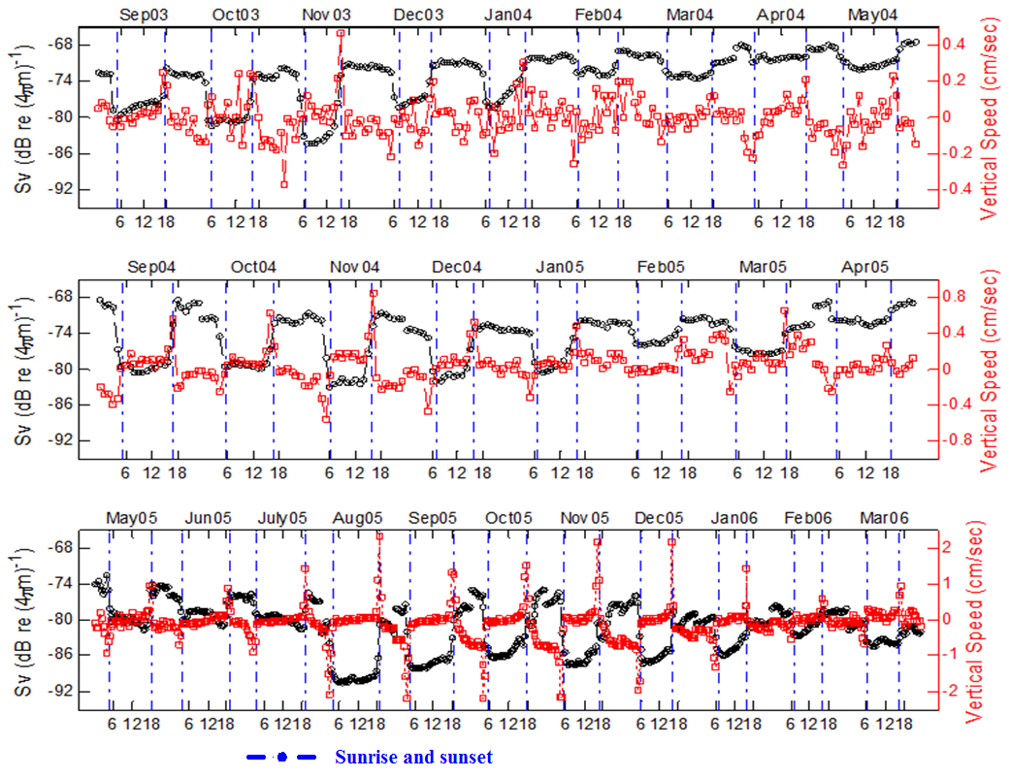
Biological Monitoring
The marked daily cycle reveals the diel vertical migration (DVM) performed by several species of zooplankton population.
The dominant vertical movement involving a 24 h cycle in the three analyzed periods is the nocturnal (or normal) pattern characterized by the swimming upward at the sunset and downward at the sunrise.
Notes:
RESULTS
At seasonal scale, the biomass follows the NPP signal with a delay of about 1 month having higher values in April and May and a secondary maximum in January or February; lower values are generally observed in autumn.
The prevailing vertical migration pattern is the 24 hours cycle performed by the zooplankton swimming upward at sunset and downward at sunrise. A second pattern having a 12 hours cycle is also identified, the twilight migration, in particular in the measurements with 30 minutes temporal resolution.
Furthermore, the analysis of both Sv and vertical velocity data suggests that changes in composition of the zooplankton population may occur during the three years of continuous monitoring.
Although no biological sampling was performed during the experiments, the results of several studies made in adjacent areas and the zooplankton composition there reported can help in interpreting the findings of this ADCP data analysis. Among the mesozooplanktonic species abundantly found in those studies such as Clausocalanus spp., Paracalanus spp. and Oithona spp, no one species shows a strong diel vertical migration. Indeed, only species of Scolecithricidae family show significant DVM in the area, confirming previous information about the presence of a few strong migrants in the Mediterranean Sea. Thus, it may be supposed that the species mainly responsible for the strong Sv signal found in some periods of this study, at times of small biomass, are ascribable to the macroplanktonic/micronektonic component. Particularly, the area is dominated by the euphausiid Meganyctiphanes norvegica which attains its maximum abundance values in August--September. This species is known to perform wide vertical migration and it could be responsible for the maximum amplitude found in ADCP data recorded in September 2005.
Furthermore, other previous investigations point out that the Ligurian Sea is characterized by different zooplankton populations whose distribution is related to the main hydrological features of this basin.
Water masses and marine circulation of the whole Mediterranean Sea, and particularly in the Ligurian Basin, underwent major changes over the three years of the study. The contemporaneous measurements of sea currents show a significant modification in the study area, with an anticlockwise rotation from north to west and a decrease of intensity. This may lead to the dominance of different zooplankton associations, related to changes in current intensity and direction, as in a long-term study in the Gulf of Tigullio, an area adjacent to the ADCP mooring position.
Although more qualitative than quantitative, the results of this study clearly show the skill of ADCP to highlight some characteristics of the zooplankton population that the usual biological observations hardly fail to grasp. Particularly, they show the important role of the time at which the discrete biological sampling is carried out. Thus, in the future, the joint use of long-term continuous monitoring by ADCP and periodic net samplings may be a good observational strategy for deepening the zooplankton knowledge. Nevertheless, at present, the re-examination of backscatter signals of many long time series of ADCP data that have been collected to estimate horizontal and vertical oceanic currents can also contribute to the biological monitoring of the oceans, even in the absence of corresponding in situ direct observations.
A re-analysis of available acoustic data time series acquired by ADCP can contribute to deepen the zooplankton knowledge especially their migratory patterns although the available data are directed to other types of studies.

Slide 9
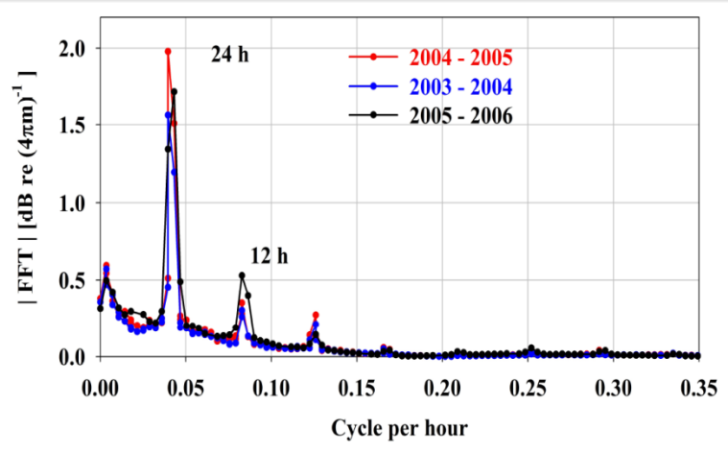
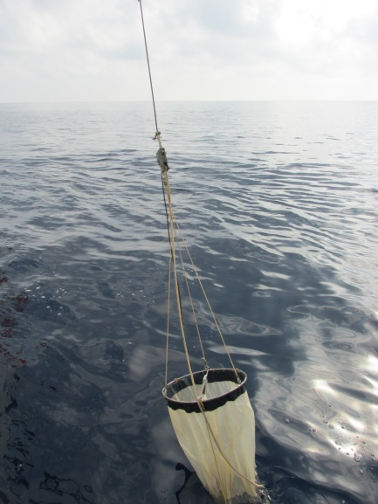

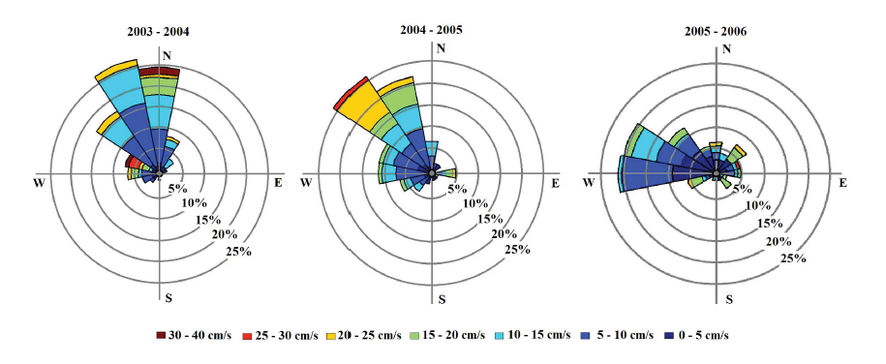
Biological Monitoring
The spectral analysis performed on the three time series at the shared depth of 40 m revealed not only a signal with a 24 h cycle but also a secondary 12 h peak attributable to a different DVM pattern, the twilight migration.
Species mainly responsible of normal and twilight migration belong to the macroplanktonic / micronektonic component (euphausiid Meganyctiphanes Norvegica).
Vertical velocities during the first deployment didn’t show any particular seasonal pattern, but rather single episodes whose amplitude was less in Spring.
On the contrary, a weak seasonal trend may be detected for the data collected during the second and third periods.
This might suggest changes in composition of zooplankton population in correspondence to a significant modification of the current in the study area, with an anticlockwise rotation from north to west and a decrease of intensity.
Notes:
1. http://www.science.oregonstate.edu/ocean.productivity
2. Monthly mean daily cycle of backscatter strength values at different depths.
Considering the normal delay of about 1 month between peaks of surface production and the increase in zooplankton biomass values of NPP may help to interpret the ADCP observed profiles.
The measure of the echo intensity scattered by the ocean is usually given in terms of volume backscattering strength (Sv) in dB re (4 m)−1.
The backscatter strength (Sv) was computed for each beam and then averaged following the expression proposed by Deines (1999) and Gostiaux and Varen Haren (2010).
The used Sv values have been computed using Eq. (5), discarding the bin closest to the transducer, as well as the one closest to the sea surface since it may be strongly affected by the atmosphere.
The pattern of backscattering strength values is consistent with NPP trends with an expected delay of about 1 month between the peak of surface primary production and the response by the zooplankton community. Indeed, the peak of zooplankton biomass is recorded in April–May (Fig. 4) after the peak of NPP in March–April.
Despite the significant inter-annual differences, a fairly constant characteristic in the time series of the monthly mean hourly Sv data is the presence of a marked daily cycle, with
low values during the daylight and high ones in the night. In correspondence with the sudden changes in the Sv signal, negative peaks in the early morning and positive ones in the afternoon are found in the monthly time series of the vertical velocity mean hourly values.
A noteworthy agreement results between the time of sunrise and sunset at the mooring position, and the time at which the lowest and highest daily values of both vertical velocity and Sv hourly changes occur, especially for the third period when the used sampling time is set at 30 min. It should be noted that significant values of vertical velocity are recorded almost exclusively for a short time around dusk and dawn.
This characteristic suggests that these velocities are related mainly to displacements of the scatter elements rather than to vertical motions of the water masses.
Results mentioned above can be ascribed to the diel vertical migration performed by several species of the zooplankton population. This is a vertical movement, generally involving a 24 h cycle, the causes of which are not yet fully understood (Ringelberg, 2010). Three main patterns have been identified: “normal” or “nocturnal” DVM involves animals moving
deeper in the water column during the day and shallower at night. A less common behaviour is exhibited by a slow descent following arrival at the surface at dusk, and a subsequent second ascent to the surface towards the end of the night, prior to the dawn descent (“twilight migration”). Other species or live stages undergo “reverse migration”, where the zooplankton ascend at dawn and descend at dusk.

Slide 10
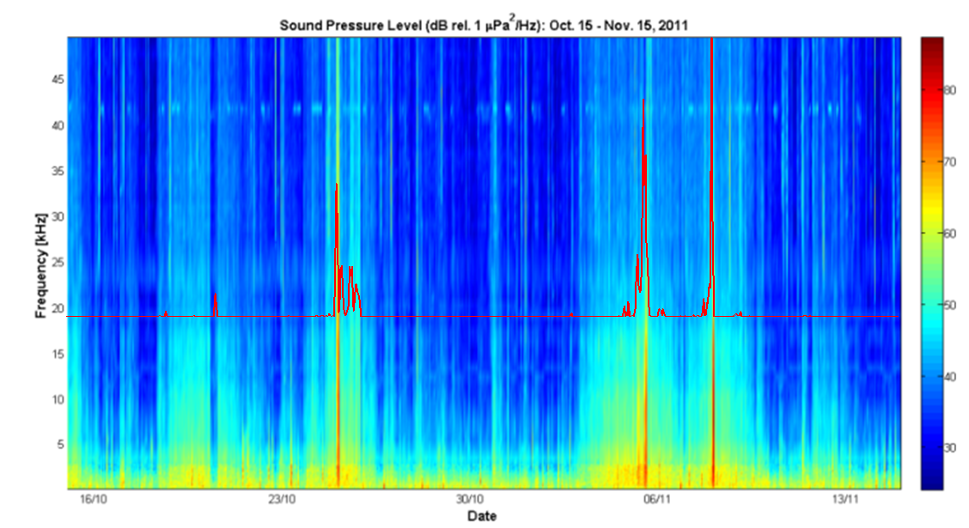
The “Soundscape” in the Ligurian Sea
with Dr. J. Nystuen (APL, USA), E. Anagnostou (UCONN, USA)
Background sound in the ocean is a combination of natural and man-made sounds.
Spectral features of sound clips can be used to detect, classify and quantify processes responsible for ambient noise in the ocean.
Experiment from June 2011 up to May 2012
Acoustic measurements from an hydrophone deployed off-shore at the center of the basin.
Meteorological measurements from the W1-M3A observatory.
Rainfall estimate from a network of operational meteorological radars.
Ship traffic in the basin from AIS data.
[dB]

Slide 11
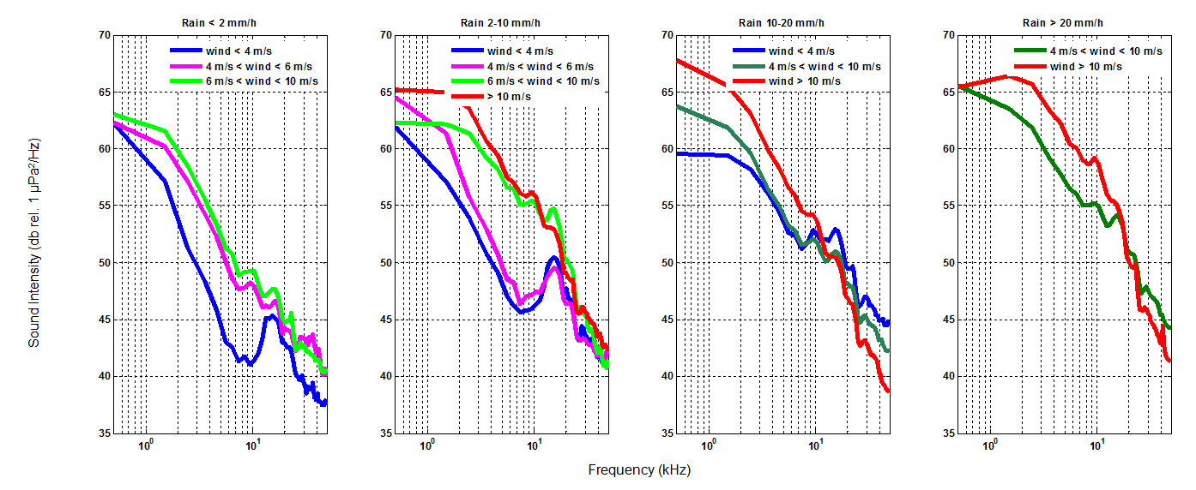
Rain Spectra
Heavy rainfall, rainfall and drizzle phenomena show unique spectral features that allow their clear identification working in the frequency band from 2 kHz up to 10 kHz.
peak in the band 12-22 kHz → drizzle phenomena.
intense sound at 10 kHz → rain events.
peak in the band 1-2 kHz → heavy/convective rain.

Slide 12
Wind spectra
Relationship between the wind blowing over the ocean and the underwater noise is well known.
The sound produced by wind is due to the wave breaking and it is radiated from bubbles trapped under water at the wave’s leading edge. Falling rain produces underwater sound in the same frequency band, but underwater sound levels produced by breaking waves and rainfall have distinctive shapes when plotted versus frequency.
The sound levels produced by breaking waves decrease with increasing frequency.
The spectra, due to the wind action over the sea surface, show shapes depending on the bubbles size distribution and levels controlled by the density of breaking waves, on their turn related to the wind speed.

Slide 13
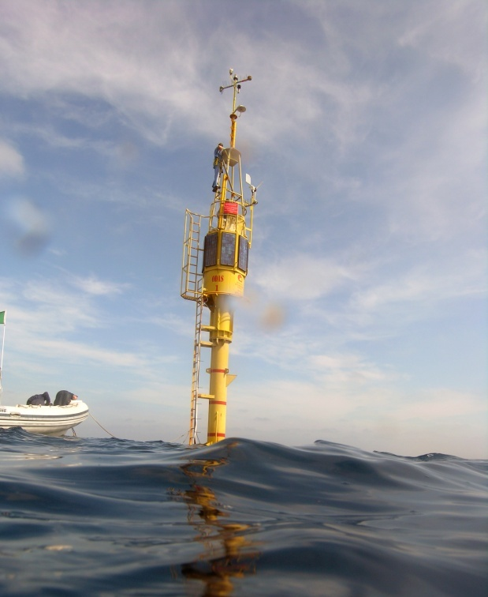
W1-M3A
Multidisciplinary Off-Shore Observatory
Contacts:
Sara Pensieri – sara.pensieri@ge.issia.cnr.it
Roberto Bozzano – roberto.bozzano@cnr.it

Slide 14
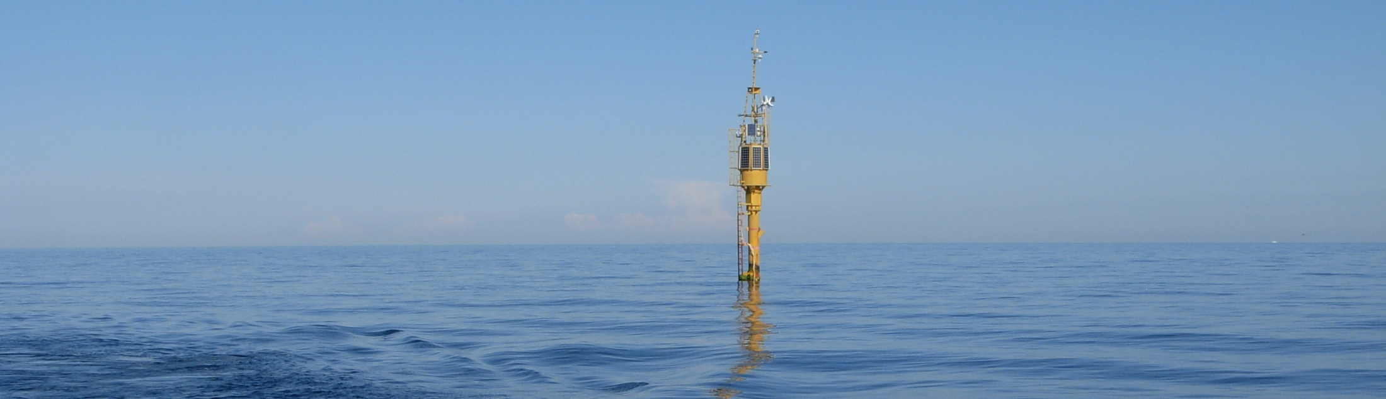
Conclusions
The effective management, monitoring and protection of the marine ecosystem require the use of multi-variable near real-time measurements combined to advanced physical and ecological numerical modeling.
Features:
Unique capability for vertical coverage (i.e. atmospheric and oceanic surface boundary layer and full water column coverage)
Calibrated long sustained timeseries allows for observations of small changes and climatic trends.
Measurements collected at high sampling rate can resolve highly variable (rapid) processes and events.
Capable of simultaneous measurements of many variables which is best chance to discover linkage and forcing between parameters.
Objectives:
To collect met-ocean parameters over the ocean for:
Validating satellite data
Improving weather and ocean state prediction
Monitoring the marine environment
Notes:
W1-M3A is one of the few off-shore observatories in the Mediterranean Sea having multidisciplinary capabilities to investigate the physical processes involving the atmosphere, the ocean interior and their interactions.

Slide 15
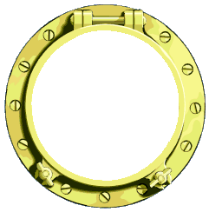
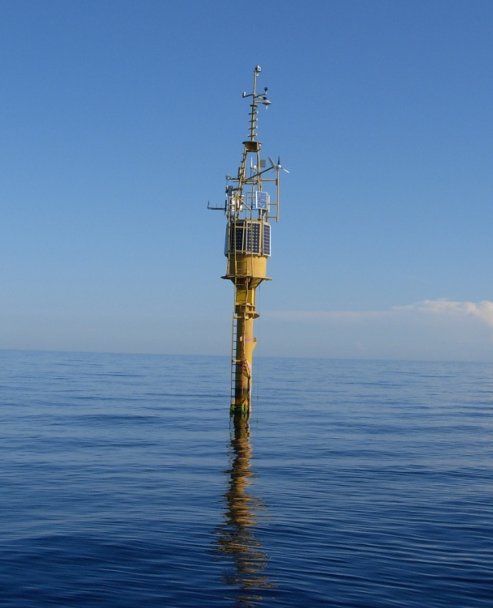
Research Topics
The effective management, monitoring and protection of the marine ecosystem require the use of multi-variable near real-time measurements combined to advanced physical and ecological numerical modeling tools.
The multidisciplinary nature of the W1-M3A observatory and its capability to operate on a long term basis allow to:
Support to & evaluate
remote sensed data
Monitor air-sea interactions processes
Investigate physical and bio-geochemical processes in the ocean

Slide 16
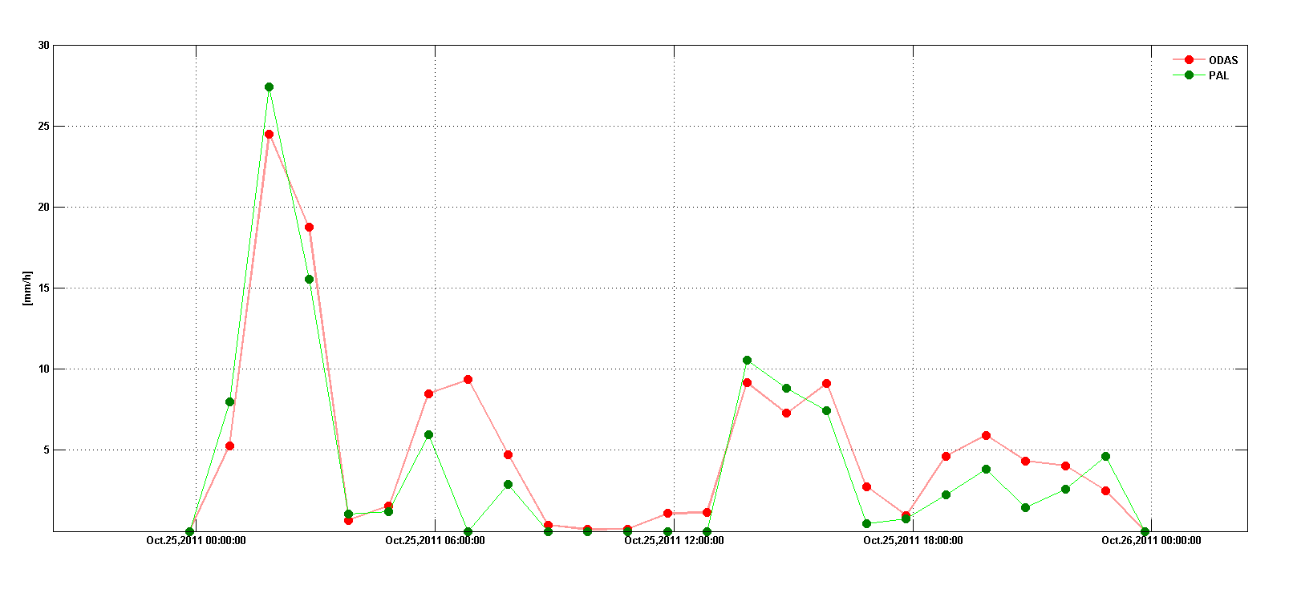

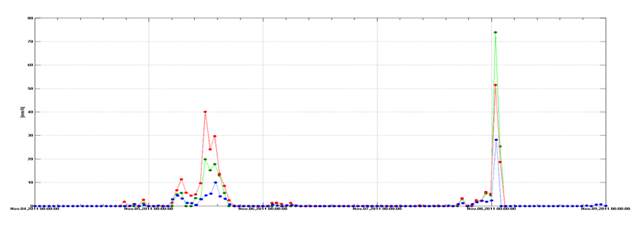
Rainfall Quantification through Acoustics
The sound pressure level at 5 kHz is used for rainfall quantification since it shows both a dynamic range referring to the rainfall rate and it is not widely affected by wind generated sound.
where SPL5 is the sound pressure level at 5 kHz relative to 1 μPa²Hz⁻¹, α and β are the intercept and the slope of the linear regression for SPL5 and the logarithmic rainfall rate and γ is a bias correction factor.
October 25, 2011
Buoy rain gauge
PAL
November 4-9, 2011
Buoy rain gauge
PAL
Radar

Slide 17
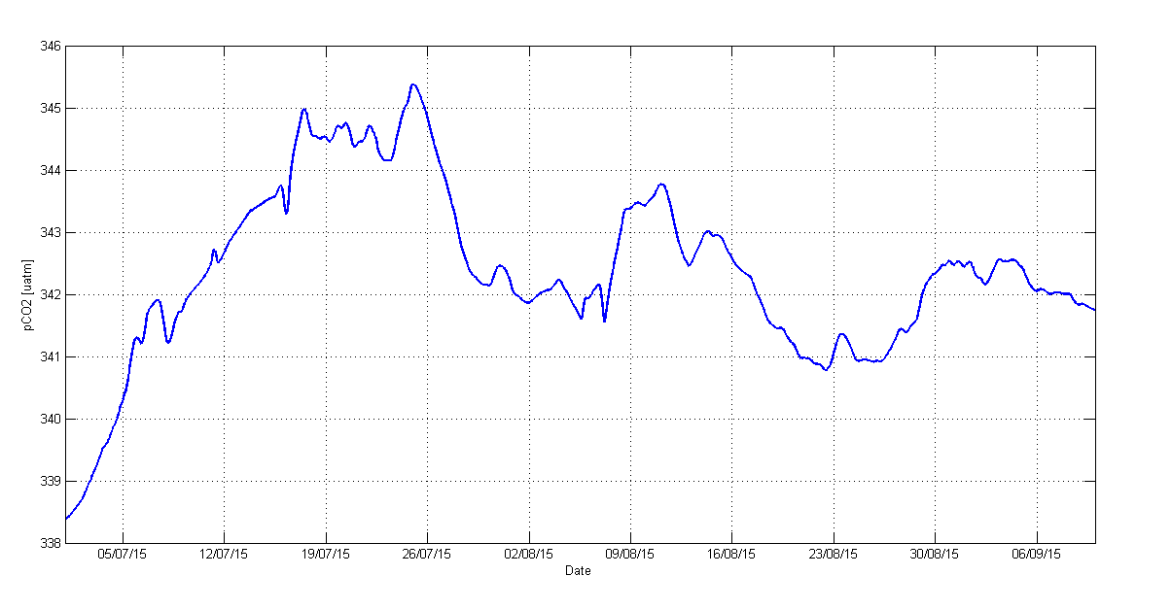
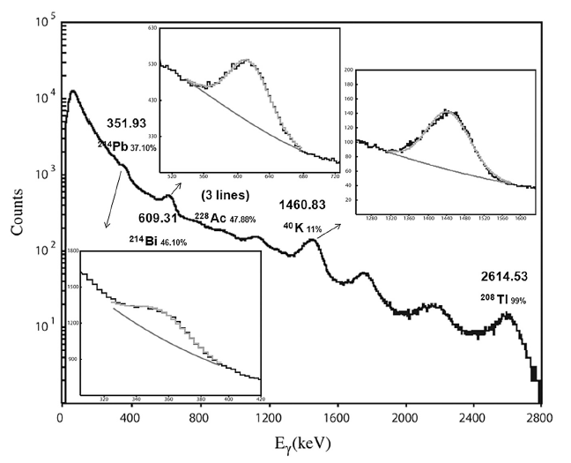
FixO3 On Going Activities
SA: Ligurian Sea heat budget and water quality analysis
TNA: Underwater Sound and Radon measurements of rainfall and wind at sea
Deployment of an underwater passive acoustic device coupled to an environmental gamma ray detector to study the environmental total gamma ray intensity increase due to high precipitation events and to correlate the concentration of radon daughters with precipitation rates (as calculated with other methods e.g., in-situ direct and indirect, remotely sensed) and cloud height.
User: HCMR, Greece.
from G. Eleftheriou et al.
doi:10.1016/j.apradiso.2013.08.007

Slide 18


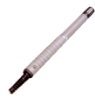













Payloads
OPERATIONAL
Meteorological package
Atmospheric pressure
2D-wind speed and direction
Air temperature and relative humidity
Short- and long-wave radiation
Compact weather station (atmospheric pressure, wind speed and direction, air temperature and relative humidity, rainfall)
Oceanographic package
  Temperature (surface buoy: 0, 6, 12, 20, 28, 36 m; mooring: 130, 190, 230, 350, 550, 950 m)‏
  Salinity (surface buoy: 6, 20, 36 m; mooring: 130, 190, 350, 550, 950 m)‏
  Pressure (36 m)‏
PRE-OPERATIONAL
Wave package
Wave statistics
Roll, pitch, vertical acceleration
Camera
Bio-geochemical package
  Dissolved oxygen (6 m)
  Chlorophyll-a and turbidity (6 m)
  Nutrients (20 m)‏
EXPERIMENTAL
Turbolence package
3D wind-speed and direction
Roll, pitch, yaw
CO₂ package
  pCO₂ (6 m)
  Atmospheric CO₂

